Slide 1
What is Quantitative Colocalisation?
“Under the conditions of proportional co-distribution, points of the scatterplot cluster around a straight line, whose slope reflects the ratio of the fluorescence of the two probes.”
Dunn et al., Am J Physiol Cell Physiol, 2011

Slide 2
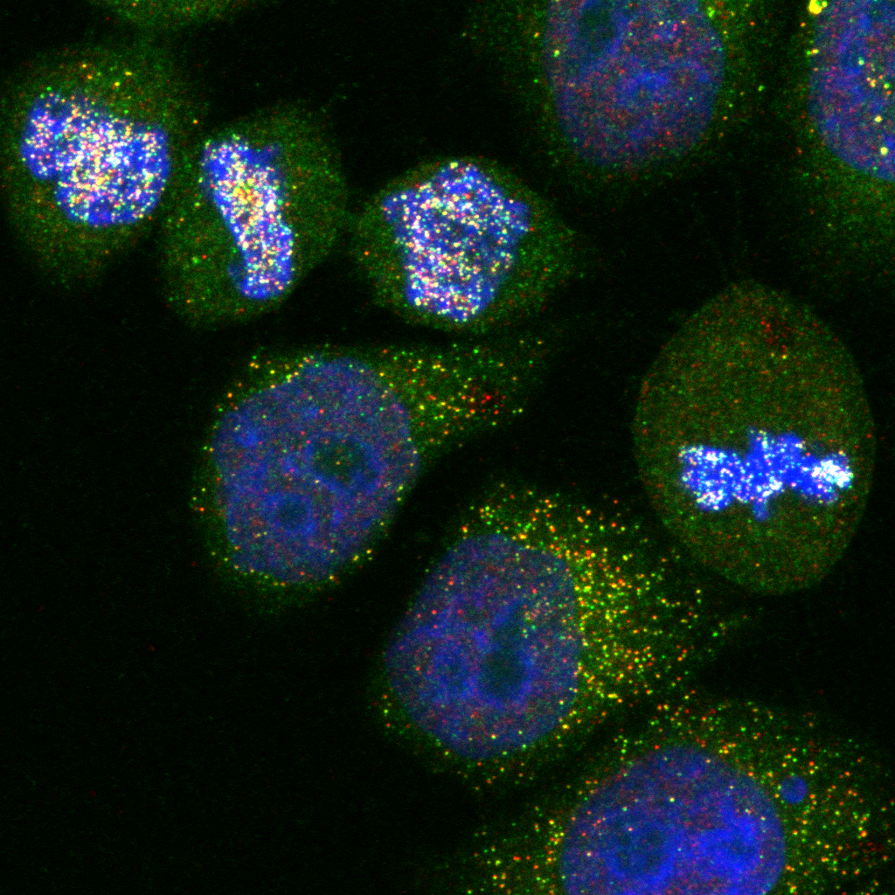
Two criteria must be met:
Co-occurrence - spatial overlap of probes
Correlation - probes are co-distributed
Distribution may overlap, but not proportionally
DAPI will overlap with nuclear proteins, but will unlikely be proportional

Slide 3
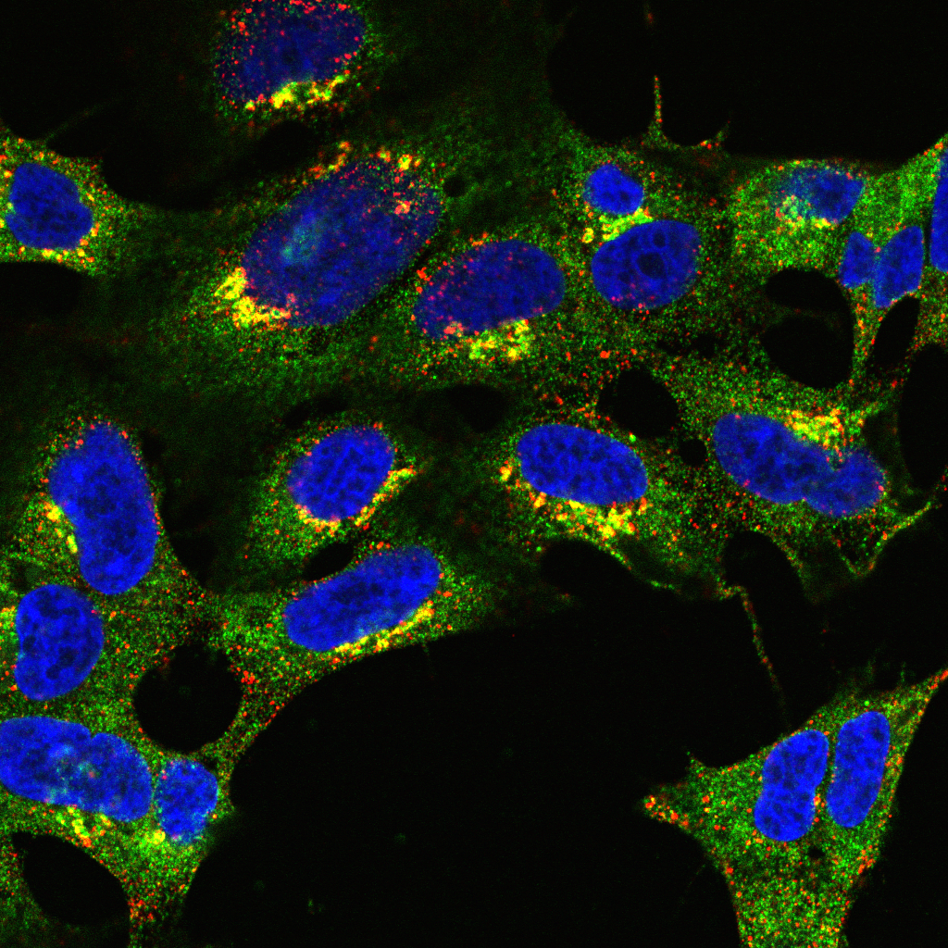
Correlative/intensity-based approaches

Slide 4
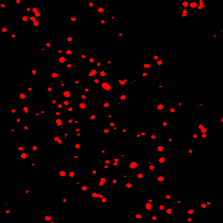
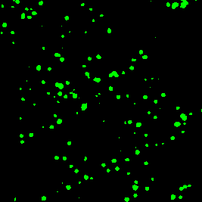
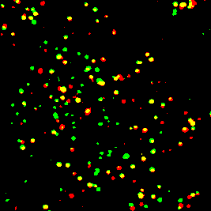
Intensity-based correlation coefficients
Pearsons
Analysis of signal correlation
Spearmans
Similar to Pearsons
Less sensitive to outliers
Manders
Analysis of signal overlap

Slide 5
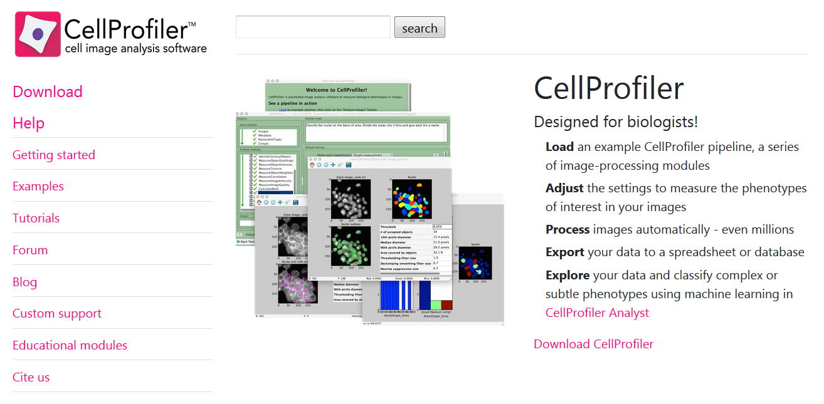
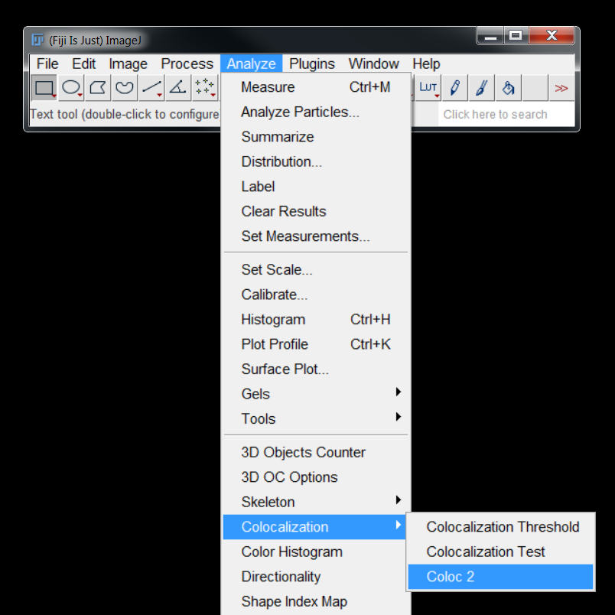
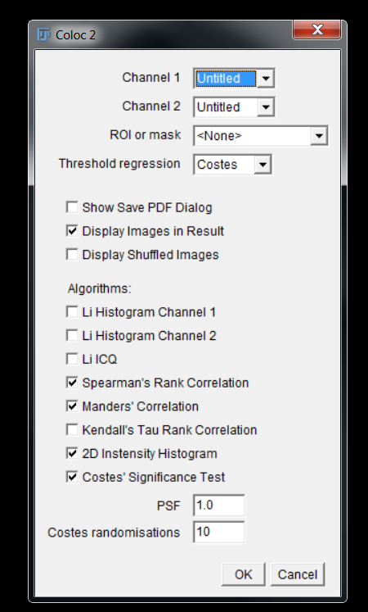
COLOC2 – FIJI Plugin for colocalisation analysis

Slide 6
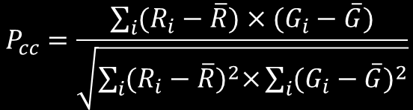
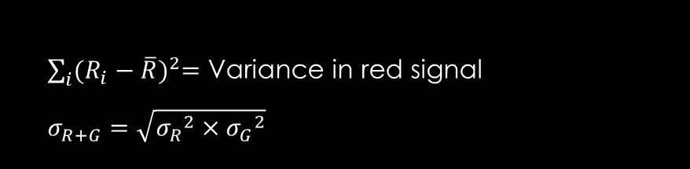
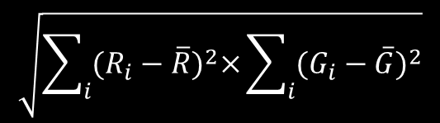
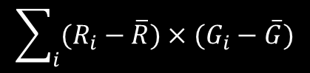
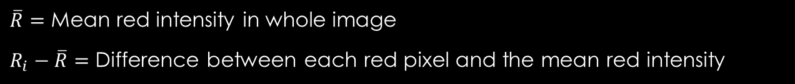
Pearson’s correlation coefficient
$$P_{cc}=\frac{\sum_{i}{(R_{i}−\overline{R})×(G_{i}−\overline{G})}}{\sqrt{\sum_{i}{{(R_{i}−\overline{R})}^{2}×}\sum_{i}{{(G_{i}−\overline{G})}^{2}}}}$$
$$\sum_{i}{(R_{i}−\overline{R})×(G_{i}−\overline{G})}$$
$\overline{R}=$ Mean red intensity in whole image
$R_{i}−\overline{R}=$ Difference between each red pixel and the mean red intensity
$$\sqrt{\sum_{i}{{(R_{i}−\overline{R})}^{2}×}\sum_{i}{{(G_{i}−\overline{G})}^{2}}}$$
$\sum_{i}{{(R_{i}−\overline{R})}^{2}=}$ Variance in red signal
$$σ_{R+G}=\sqrt{{σ_{R}}^{2}×{σ_{G}}^{2}}$$
The coefficient is normalised to the standard deviation across the two channels to ensure that values range from -1 to +1

Slide 7
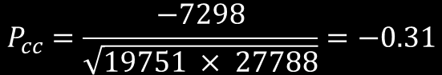
Pearson’s correlation coefficient
38.7 | 47.2
178.9 | 187.5
-74.4 | -65.9
65.9 | 74.4
-74.4 | X | -74.5 | = | 5543
-65.9 | X | 130.1 | = | -8571
65.9 | X | 15.6 | = | 1026
74.4 | X | -71.2 | = | -5297
113.3
Mean: 113.1
 |  |  |  | -7298
47.8 | 252.4
137.9 | 51.1
-74.5 | 130.1
15.6 | -71.2
5535 |  | 5550
4343 |  | 16926
4343 |  | 243
5535 |  | 5069
122.3
Mean: 122.3
19751 |  | 27788
If two targets are functionally related, their abundances will be predictably related
$$P_{cc}=\frac{−7298}{\sqrt{19751 × 27788}}=−0.31$$

Slide 8
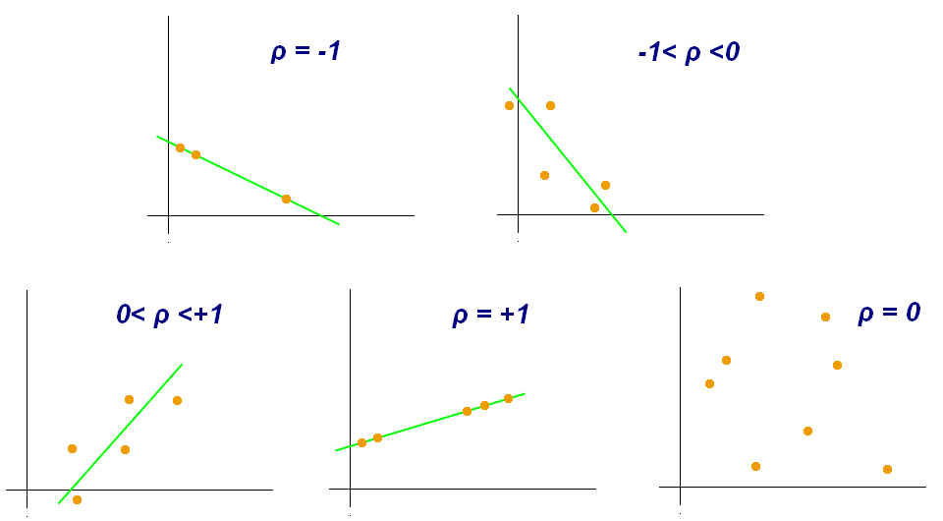
What does this number mean?
To what extent is intensity variation in one channel explained by variation in another…

Slide 9
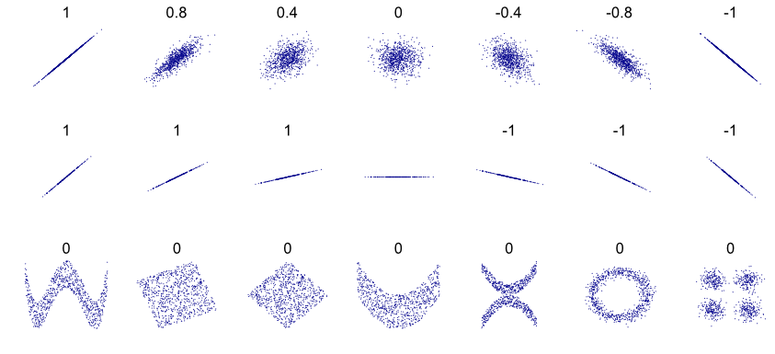
Pearsons can be the same for very different data…
…and intermediate values can be difficult to interpret

Slide 10
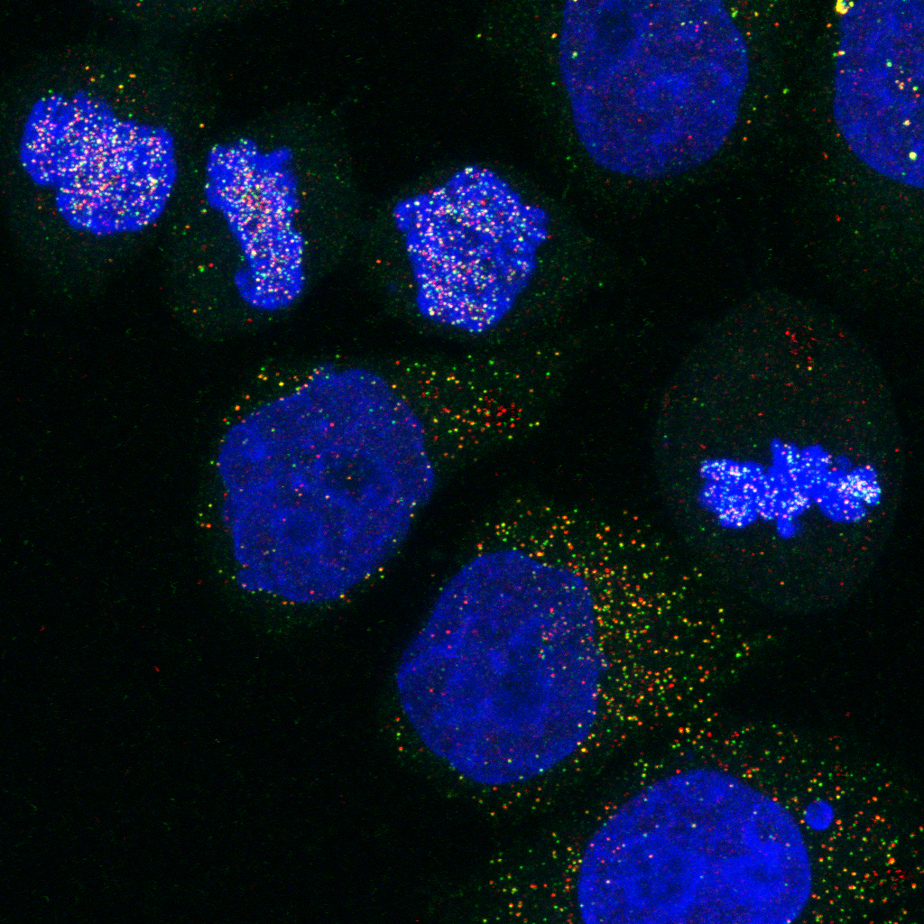
Demo 1: Pearson’S Correlation coefficient

Slide 11
Quiz 3: Pearson’S Correlation coefficient
Open the image in the Quiz 3 folder with Bio-Formats:
Using Coloc2, calculate Pearson’s correlation coefficient for the image

Slide 12
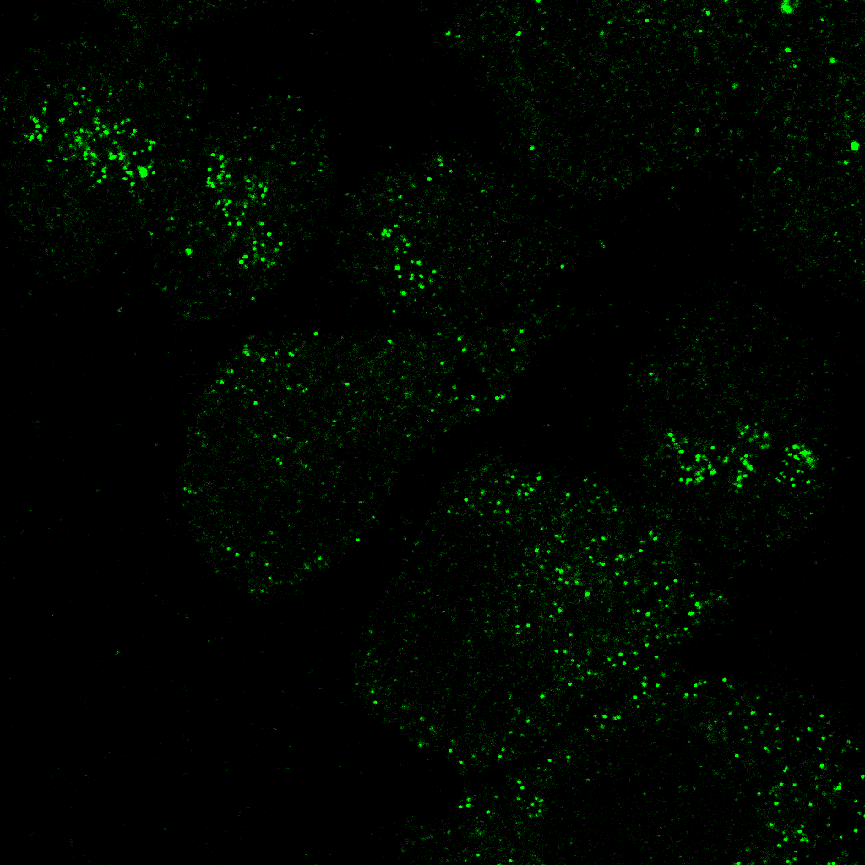
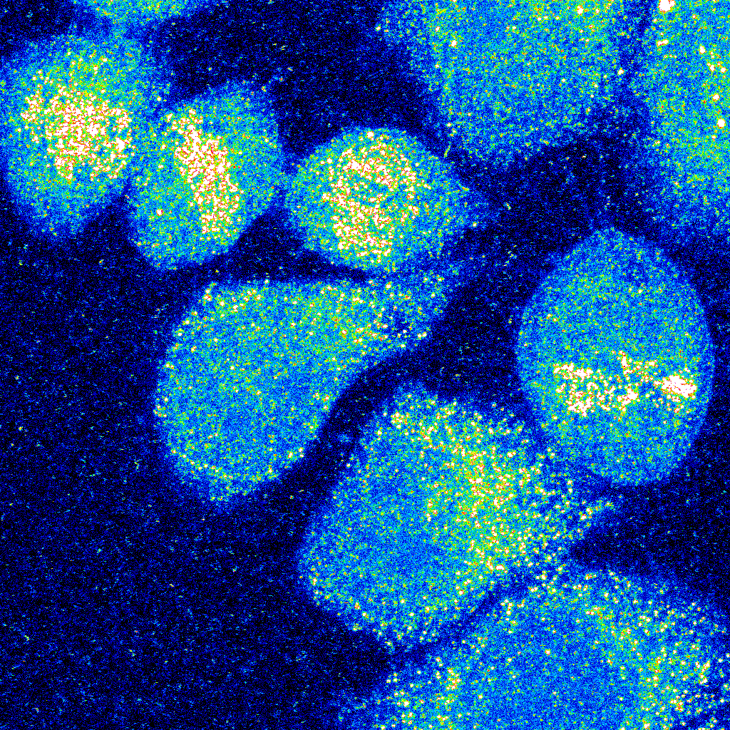
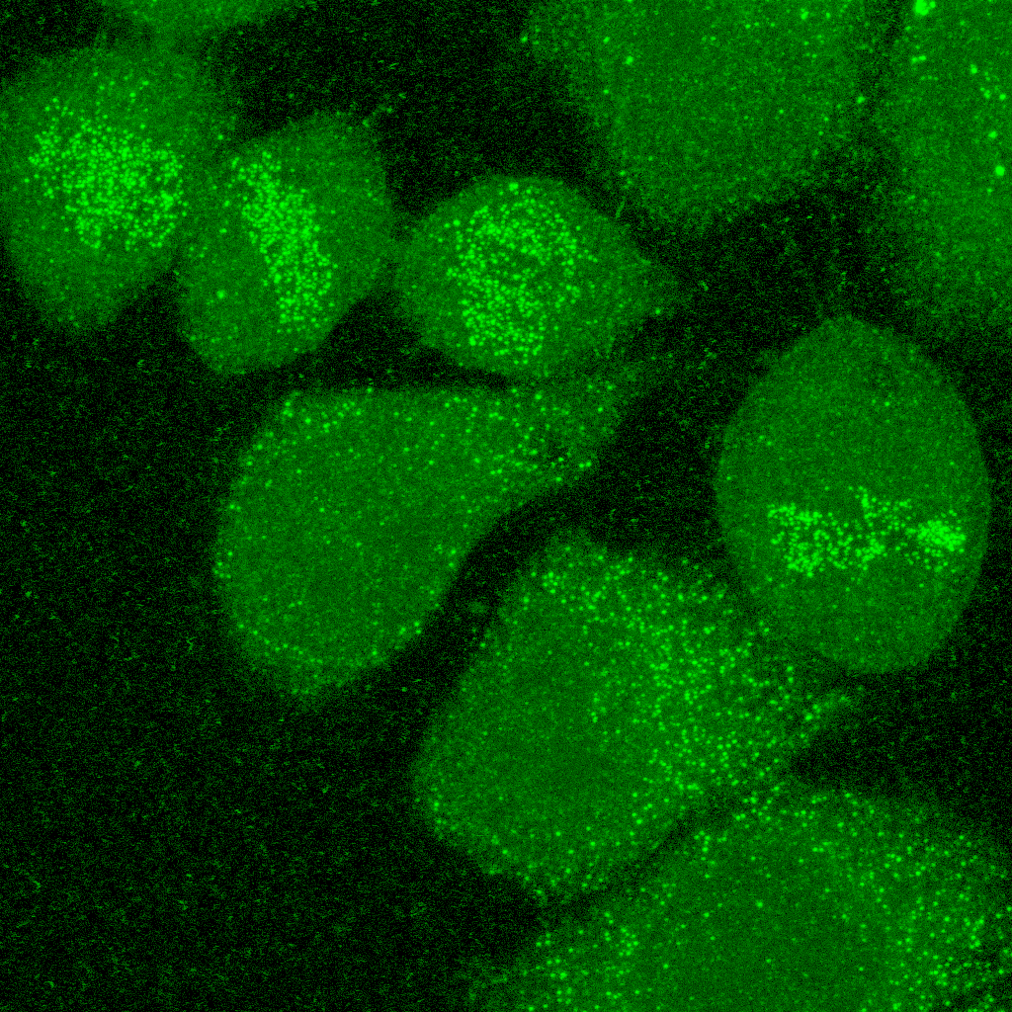
Influence of NOISE & background
“Background” refers to the amount of offset in an image
“Noise” refers to the variability in a measurement
Both have impacts on colocalisation

Slide 13
Background causes spurious results
Quantification of P_{CC} within cells indicates poor association (P_{CC} = 0.16)
When quantified over entire image, P_{CC} = 0.39
Dunn et al., Am J Physiol Cell Physiol, 2011

Slide 14
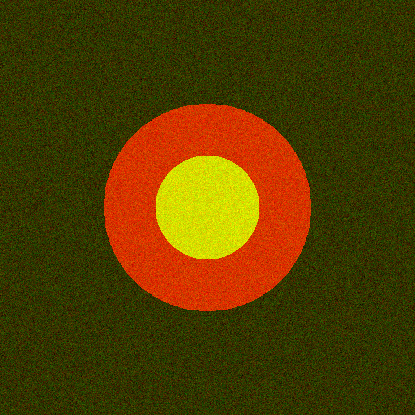
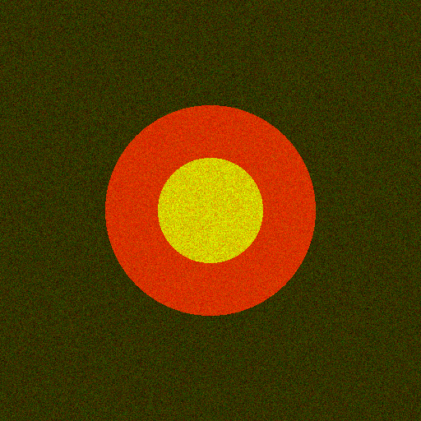
Noise results in “Less” correlation
P_{cc} = 0.41
P_{cc} = 0.33
Sample can exhibit high co-occurrence, but low correlation

Slide 15
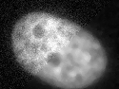
Filtering suppresses Noise
But information is lost!

Slide 16
Demo 2: Influence of background & Noise

Slide 17
Quiz 4: Influence of Background & Noise
Open the images in the Quiz 4 folder with Bio-Formats:
Using Coloc2, calculate Pearson’s correlation coefficient for both images
The images show the same field of view, but the correlation coefficients are different – why?

Slide 18
Pearson’s: Pros & Cons
PROS
CONS
Easy to measure
Broadly applicable
Independent of signal levels
Same amount of signal overlap can have dramatically different P_{CC} values
Intermediate values difficult to interpret
Background pixels artificially inflate P_{CC} values
Empty areas within cells have similar effect
Depends on linear relationship between probe intensities

Slide 19
Spearman’s correlation coefficient
Pearson’s skewed by non-linearity, such as outliers
Spearman’s similar to Pearson’s, but compares ranks rather than values
Red | Green | Rank Red | Rank Green
96 | 93 | 6 | 7
177 | 209 | 3 | 3
41 | 30 | 10 | 10
43 | 94 | 9 | 6
500 | 10000 | 1 | 1
112 | 165 | 4 | 4
102 | 234 | 5 | 2
194 | 75 | 2 | 8
79 | 104 | 7 | 5
64 | 52 | 8 | 9
P_{c} = 0.9
S_{c} = 0.1

Slide 20
Demo 3: Spearman’s Correlation Coefficient

Slide 21
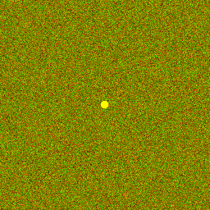
Quiz 5: Spearman’s Correlation Coefficient
Open the images in the Quiz 5 folder with Bio-Formats:
Using Coloc2, calculate Spearman’s and Pearson’s correlation coefficients for both images
Which coefficient is more appropriate to quantify colocalization in these images? Why?

Slide 22
Both measure poorly the quantity that is typically at the heart of most analyses of colocalization in cell biology:
The fraction of one family of objects that localizes with another.

Slide 23
HYBRID approach: Manders Coefficient

Slide 24
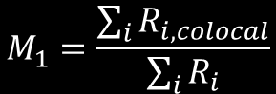
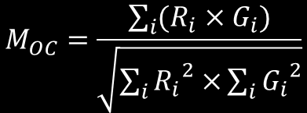
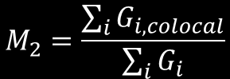
Mander’s coefficient
Overlap Coefficient:
$$M_{OC}=\frac{\sum_{i}{(R_{i}×G_{i})}}{\sqrt{\sum_{i}{{R_{i}}^{2}×}\sum_{i}{{G_{i}}^{2}}}}$$
Independent of signal proportionality
Sensitive to co-occurrence, the fraction of pixels with signals from both channels
Colocalisation Coefficient:
$$M_{1}=\frac{\sum_{i}{R_{i,colocal}}}{\sum_{i}{R_{i}}}$$
$$M_{2}=\frac{\sum_{i}{G_{i,colocal}}}{\sum_{i}{G_{i}}}$$
Problem: Image must contain meaningful “zero” values.

Slide 25
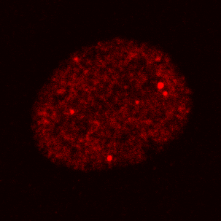
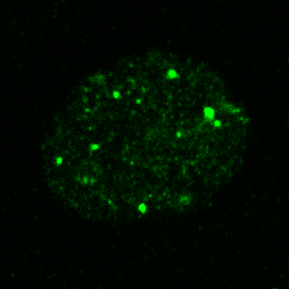
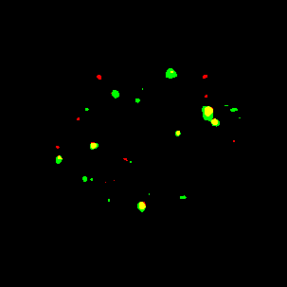
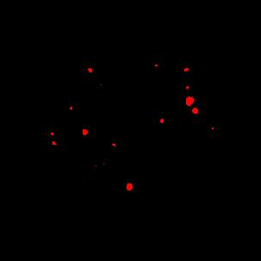
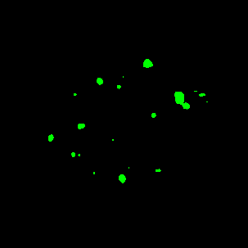
M_{red-green} = 0.59
M_{green-red} = 0.68

Slide 26
Demo 4: Manders’ Correlation Coefficient

Slide 27
Calculating Thresholds

Slide 28
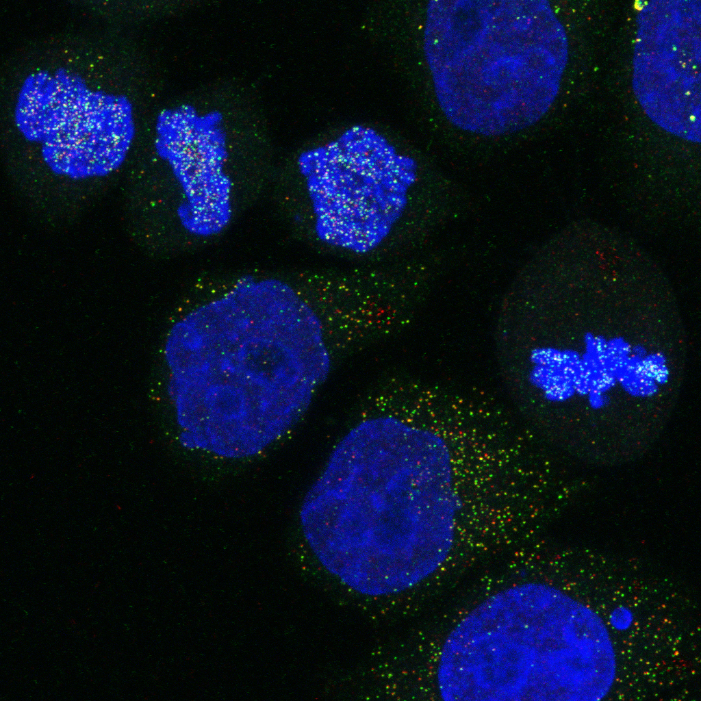
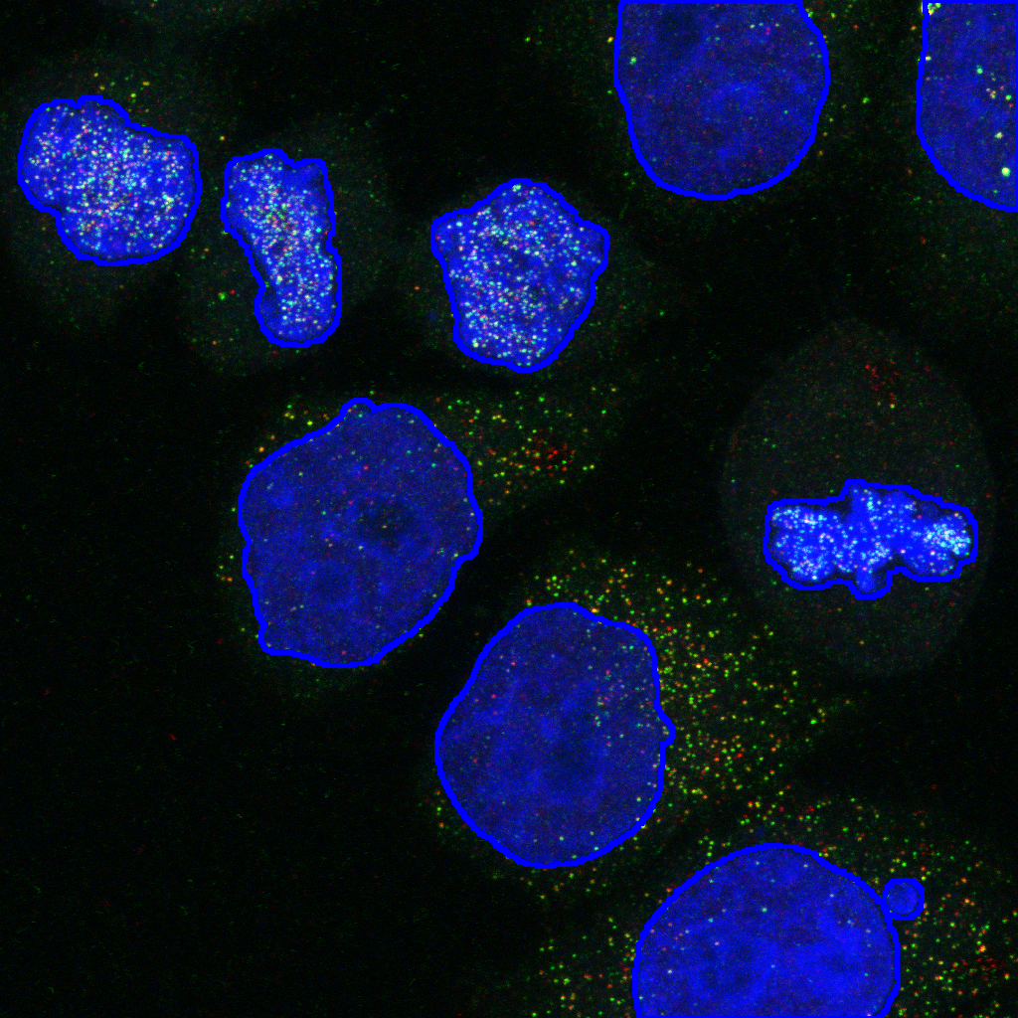
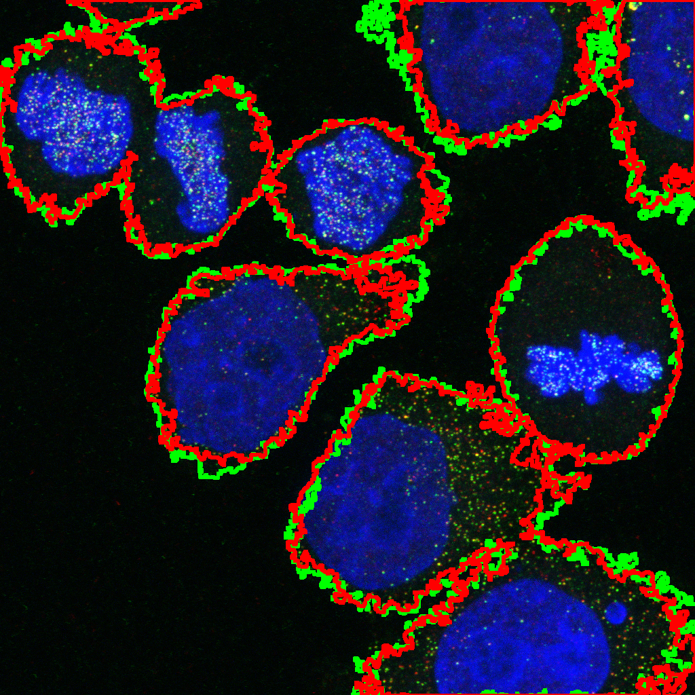
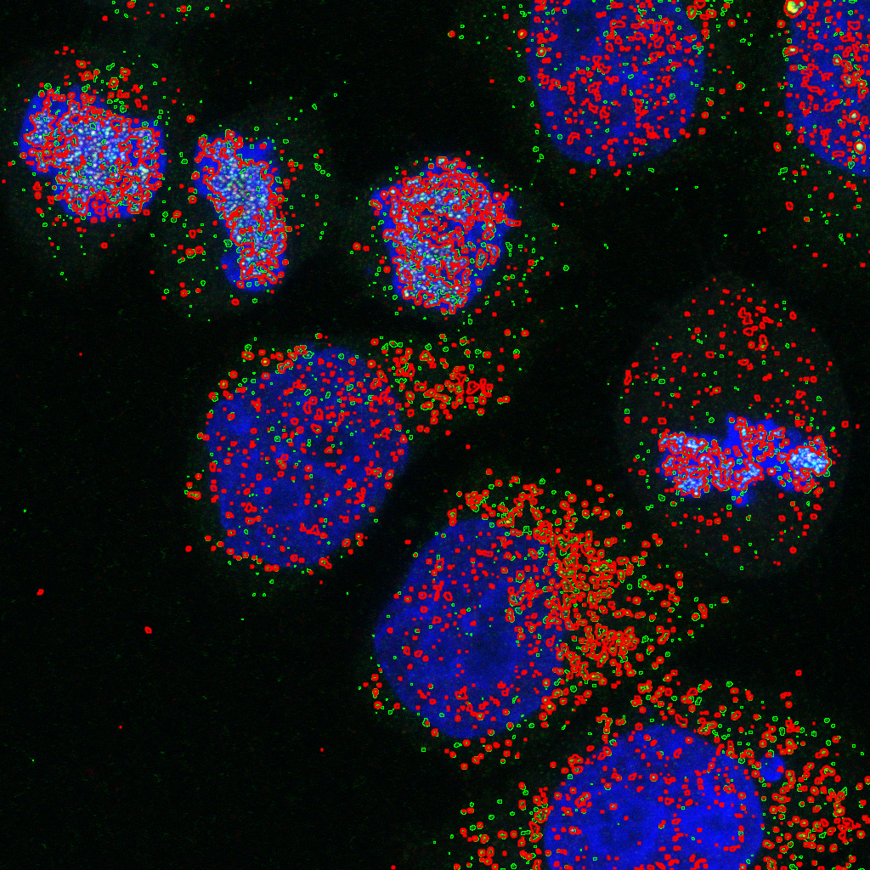

Slide 29
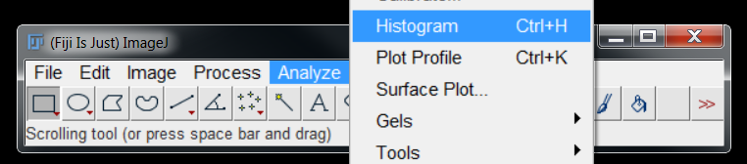

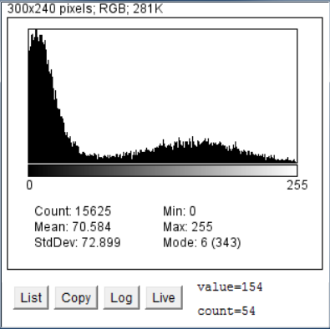
A Refresher on thresholding
“Foreground”
“Background”
Can be exploited for segmentation

Slide 30
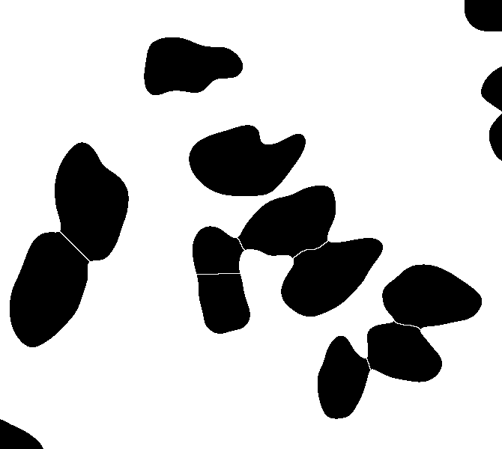
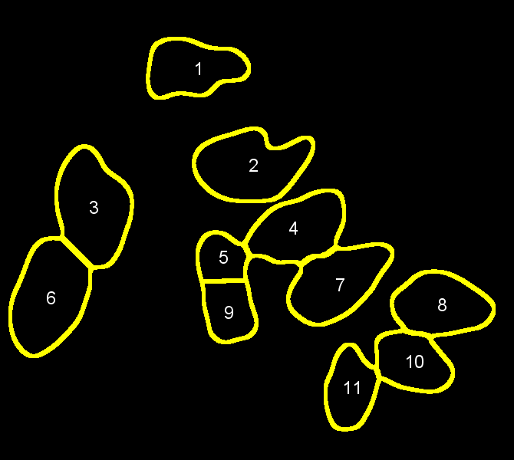
Particle Analyser generates rois
Masks and ROIS can be considered one and the same

Slide 31

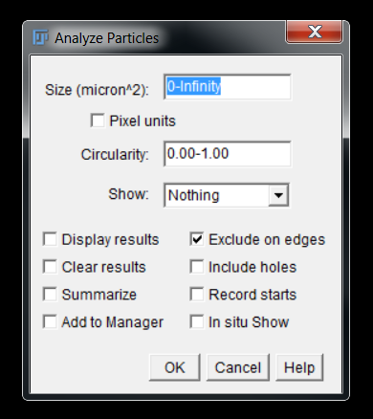
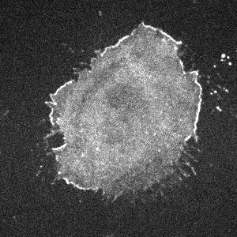
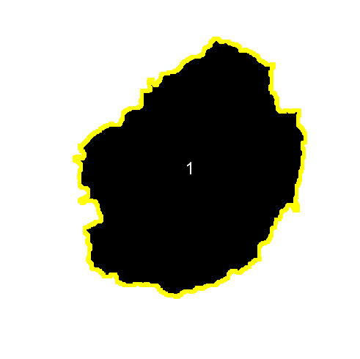
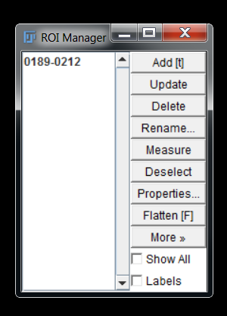
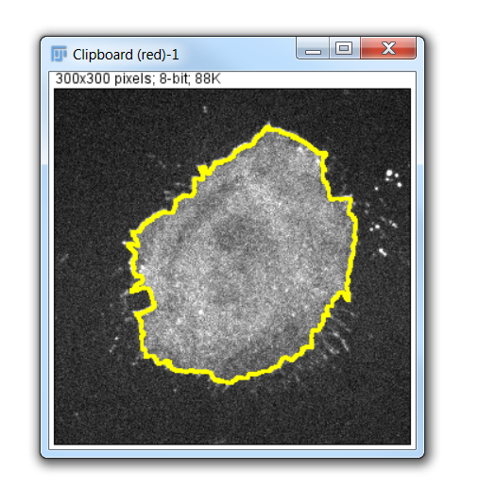

Slide 32
Costes’ Regression
T_{g} = 50
T_{g} = 90
T_{g} = 130
T_{g} = 180
T_{g} = 220
T_{r} = 200
P_{>T} = 0.90
P_{>T} = 0.80
P_{>T} = 0.70
P_{>T} = 0.60
T_{r} = 170
P_{>T} = 0.50
T_{r} = 128
P_{<T} = 0.60
P_{<T} = 0.45
P_{<T} = 0.30
P_{<T} = 0.15
P_{<T} = 0.00
T_{r} = 70
T_{r} = 50
Costes et al., Biophys J, 2004

Slide 33
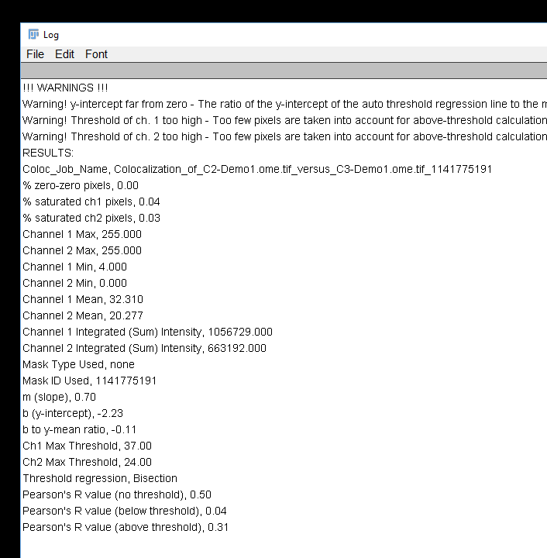
This should be close to zero

Slide 34
Demo 5: Setting Thresholds & Defining Regions

Slide 35
Quiz 6: Setting Thresholds & Defining Regions
Open the image in the Quiz 6 folder with Bio-Formats:
Use the DAPI channel to define an ROI and measure colocalisation in the other two channels
According to Pearson’s correlation coefficient, what is the extent of colocalisation between channels 2 and 3 within the nuclei?

Slide 36
Dunn et al., Am J Physiol Cell Physiol, 2011

Slide 38
Useful References
https://dx.doi.org/10.1083/jcb.200903097
https://dx.doi.org/10.1073/pnas.1711314115
https://dx.doi.org/10.1152/ajpcell.00462.2010
https://doi.org/10.1111/j.1365-2818.2006.01706.x
https://doi.org/10.1529/biophysj.103.038422
https://doi.org/10.1242/jcs.211847
https://doi.org/10.1371/journal.pone.0111983
https://doi.org/10.1038/nmeth.3587

